Slide 1
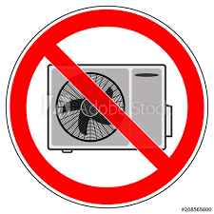
設施管理處
Facilities Management Office
NOTICE 通告
Emergency repairing work in progress
Main air-conditioning system of Main Building has been suspended until further notice.
Please accept our apology for any inconvenience that may be caused.
緊急維修
教學大樓中央冷氣暫停使用，
直至另行通知。
不便之處，敬請原諒﹗

